Slide 1


 | Slovenian experiences at the implementation of new tariffs
Andreja Ivartnik Kanduč, MSc

Slide 2

Agenda
Introduction
Methodology
Benefits
Implementation challanges
Conclusions

Slide 3
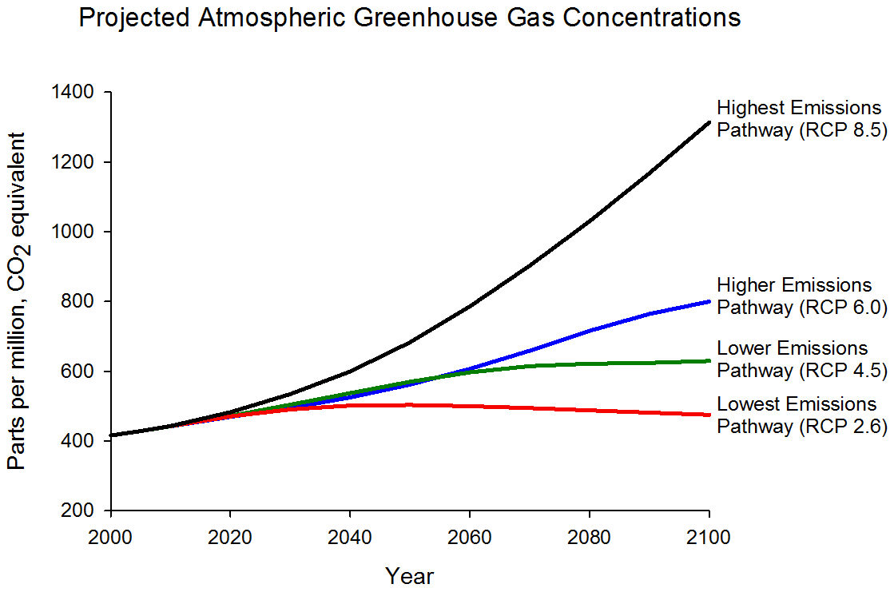





Integrated national energy and climate plan
Integration 1.650 MW photovoltaic
Integration 150 MW wind
Integration 117.371 heat pumps
Integration 200.000 electrical vehicle
4200 mio €
Notes:
Škoda po poplavah ocenjena na 3 miljarde evrov 12 mesecev po poplavah avgusta 2023 | GOV.SI

Slide 4
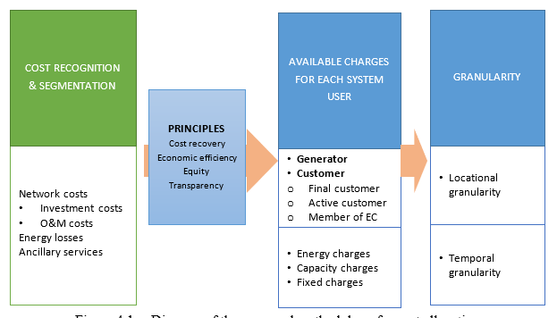
Principles for network tariff design

Slide 5
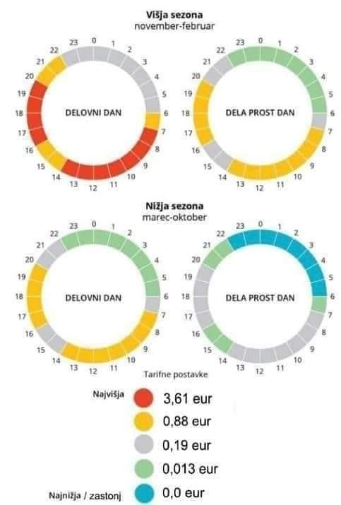
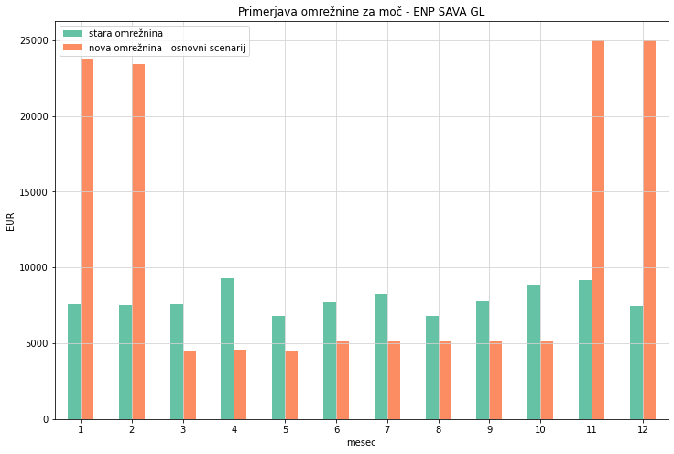
New tariff system in Slovenia

Slide 6
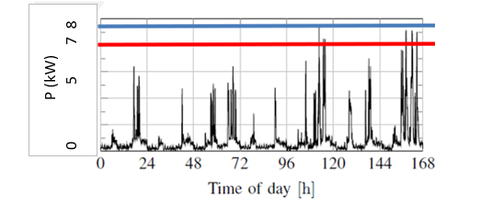
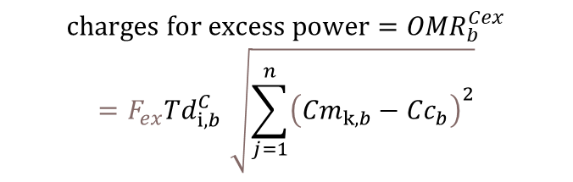
Excess power
User has 160 kW contracted power and use 400.000 kWh
Network charges | Contracted power 160 kW | Contracted power 140 kW | Contracted power 140 kW excess power 5 ur za 20 kW | Contracted power 140 kW 30 ur za 30 kW
Power | 6075,76 | 5316,29 | 5765,56 | 6967,02
Energy | 4736,43 | 4736,43 | 4736,43 | 4736,43
SUM | 10812,19 | 10052,72 | 10501,99 | 11703,45
-8%
- 3%
+ 8%
$$charges for excess power={OMR}_{b}^{Cex}$$
$${=F_{ex}Td}_{i,b}^{C}\sqrt{\sum_{j=1}^{n}{{\left({Cm}_{k,b}−{Cc}_{b}\right)}^{2}}}$$

Slide 7
Network charges impact on EV charging
Charging EV with 11 kW (assumption: for 100 km needed 20 kWh)
Different scenarios:
Old methodology before 1.10.2024 without EV (billing power = 10 kW)
Old methodology before 1.10.2024 with EV charging at night (billing power = 10 kW)
Old methodology before 1.10.2024 with EV charging during the day (billing power = 10 kW)
New methodology after 1.10.2024 without EV (agreed power is 5.3 kW)
New methodology after 1.10.2024 with EV charging in B4 and B5 (agreed power is 15 kW)
New methodology after 1.10.2024 with EV charging in B1 and B2 (agreed power is 16.3 kW)

Slide 8
Network charges impact on EV charging
  EV drives 20000 km/year and use 4000 kWh of electrical energy
  Fuse 3x25 A - conection power 17kW (charging power for hauseholds was before 1.10.2024 constant 10kW)
  Aggred power without EV – 5,3 kW
  Aggred power with EV - 16,3 kW oz 15kW
  Energy used without EV EV 8000kWh
  Energy used with EV 12000kWh
 | B1 | B2 | B3 | B4 | B5
day | 16,3 | 16,3 | 16 | 16 | 16
night | 5,3 | 5,3 | 15 | 15 | 15

Slide 9
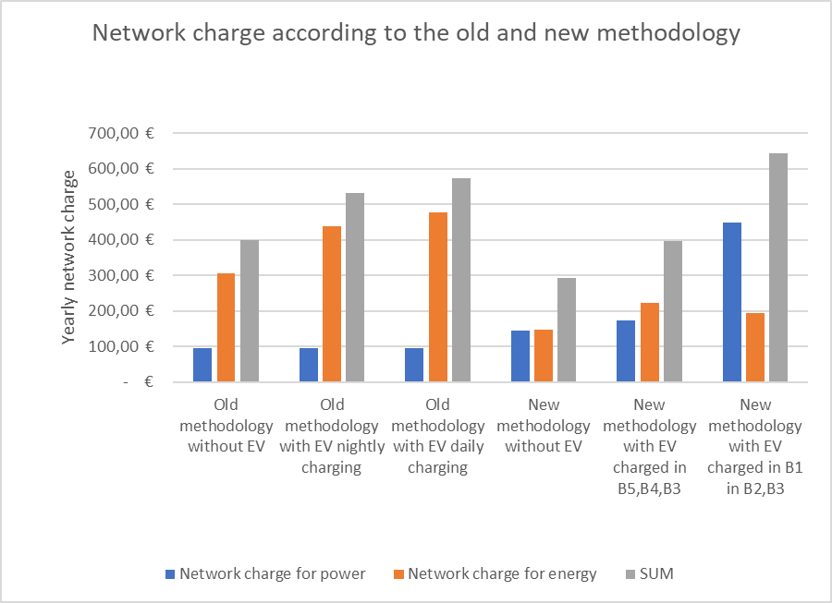
Network charges impact on EV charging
 | Old methodology without EV | Old methodology with EV nightly charging | Old methodology with EV daily charging | New methodology without EV | New methodology with EV charged in B5,B4,B3 | New methodology with EV charged in B1 in B2,B3
Network charge for power | 95,52 € | 95,52 € | 95,52 € | 145,73 € | 173,73 € | 447,45 €
Network charge for energy | 304,76 € | 437,20 € | 477,08 € | 148,20 € | 221,89 € | 194,65 €
SUM | 400,28 € | 532,72 € | 572,60 € | 293,93 € | 395,62 € | 642,10 €

Slide 10
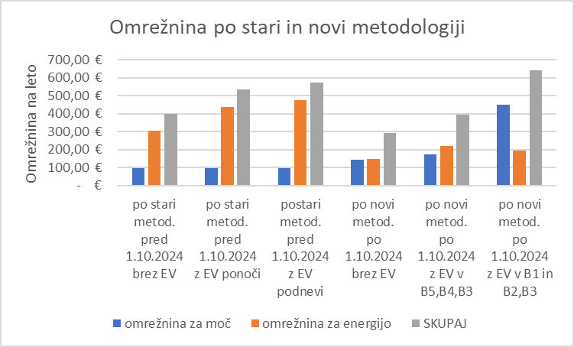
Network charges impact on EV charging
 | po stari metod. pred 1.10.2024 brez EV | po stari metod. pred 1.10.2024 z EV ponoči | postari metod. pred 1.10.2024 z EV podnevi | po novi metod. po 1.10.2024 brez EV | po novi metod. po 1.10.2024 z EV v B5,B4,B3 | po novi metod. po 1.10.2024 z EV v B1 in B2,B3
omrežnina za moč | 95,52 € | 95,52 € | 95,52 € | 145,73 € | 173,73 € | 447,45 €
omrežnina za energijo | 304,76 € | 437,20 € | 477,08 € | 148,20 € | 221,89 € | 194,65 €
SKUPAJ | 400,28 € | 532,72 € | 572,60 € | 293,93 € | 395,62 € | 642,10 €
© Elektroinštitut Milan Vidmar, 2024

Slide 11
Implementation challenges
Planned start for 1.1.2024
First postponement on 1.3.2014
Second postponement on 1.7-2024
Third postponement on 1.10.2024
DATA quality
Validation
Customer redlines
Available tools

Slide 12
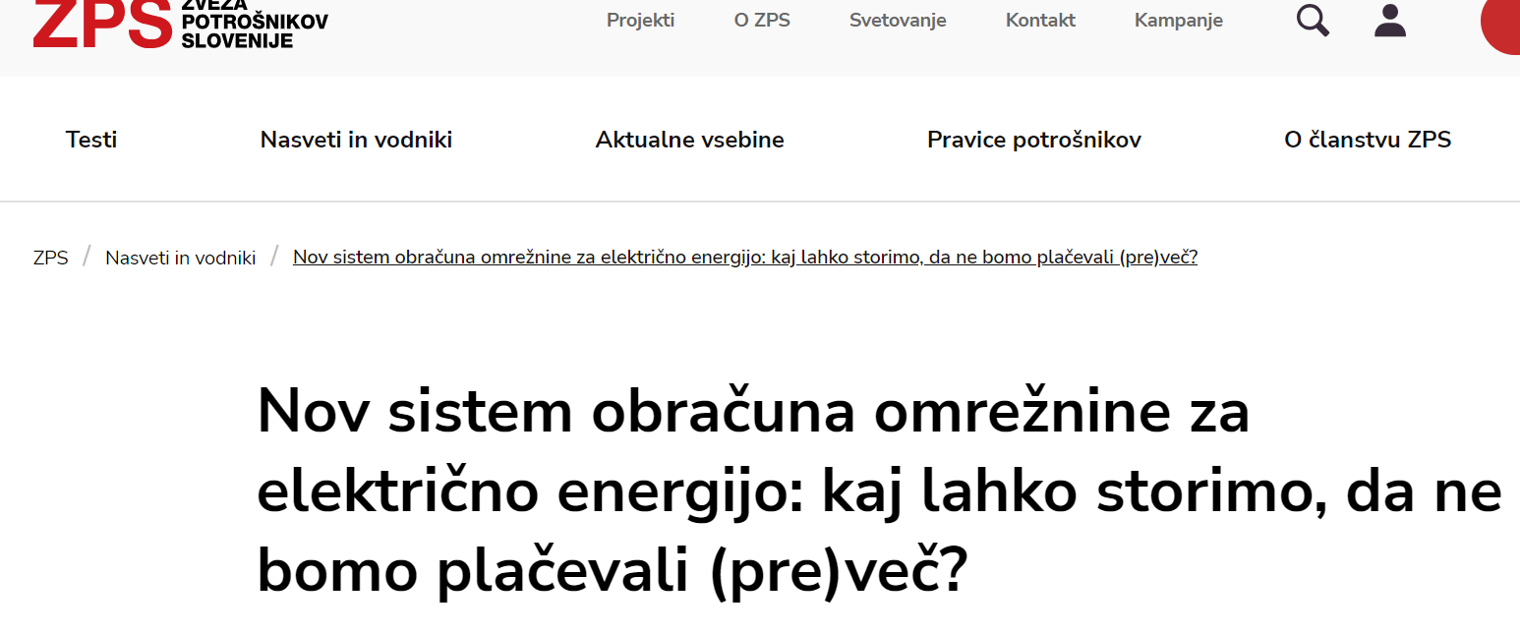

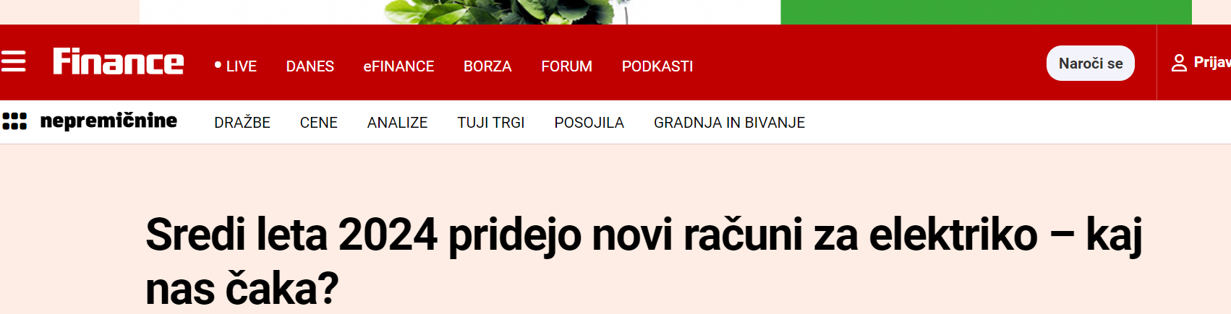
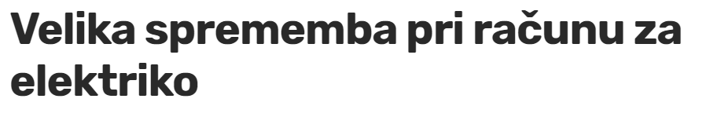
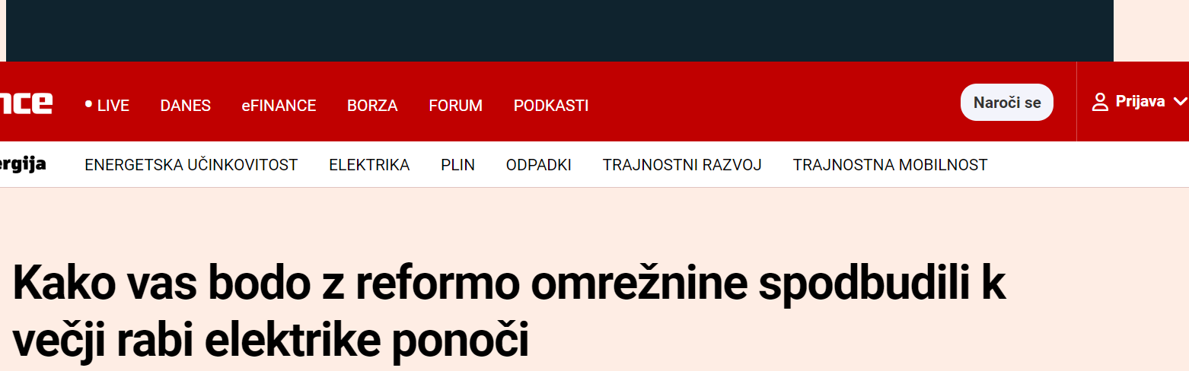

Implementation challenges

Slide 13
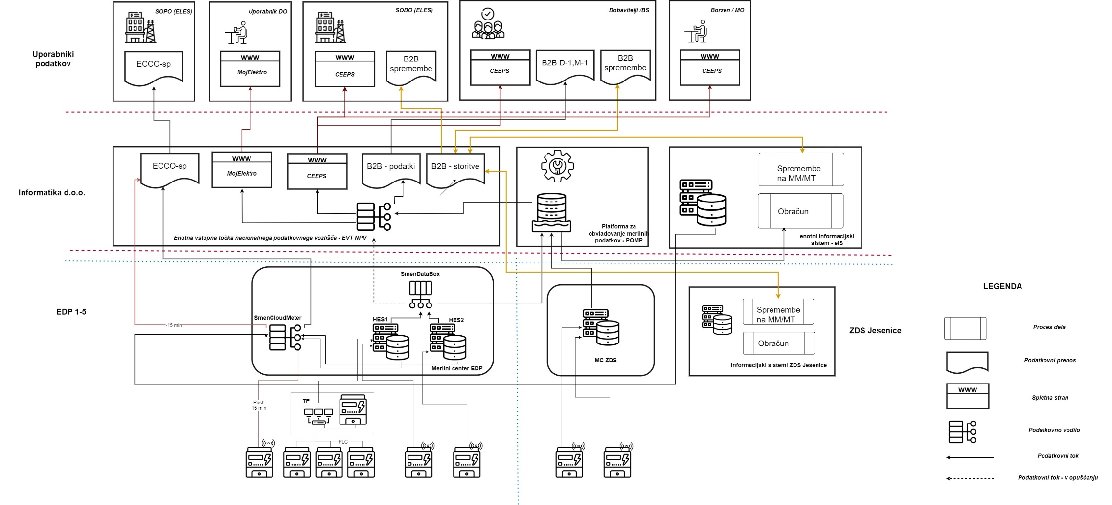
Concept integrated input point on national level

Slide 14

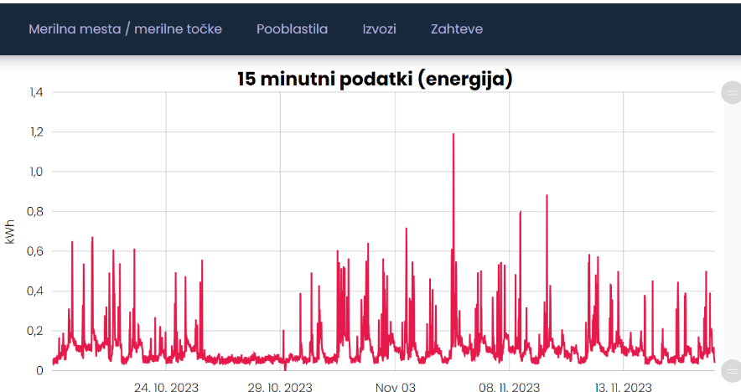
Application for customers

Slide 15
Concllusions
Make sure about data quality
Test different scenarios
Take into consideration all the stakeholders
Communicate, communicate, communicate…and communicate
Build integrated data point on national level
Do your homework, take your time

Slide 16
 | HVALA NA PAŽNJI!
 | Andreja Ivartnik Kanduč Elektroinštitut Milan Vidmar andreja.kanduc@eimv.si

