Slide 1
Digital cybersecurity
Manual cybersecurity Practices considered harmful
Dr. Nikolai Mansourov, CTO KDM Analytics

Slide 2
Agenda
Where do we still use manual cybersecurity practices?
  Reactive and proactive controls
  How do we assess risk?
  How do we correlate business impact with attack capabilities and effective controls ?
Why manual cybersecurity practices are inadequate and harmful?
How to automate some manual practices?
    Top-down vs bottom-up cybersecuity
  Digital cybersecurity platform
  Digitization of system architectures
What standards to adopt ?
Benefits of digital cybersecurity

Slide 3




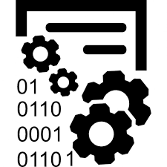
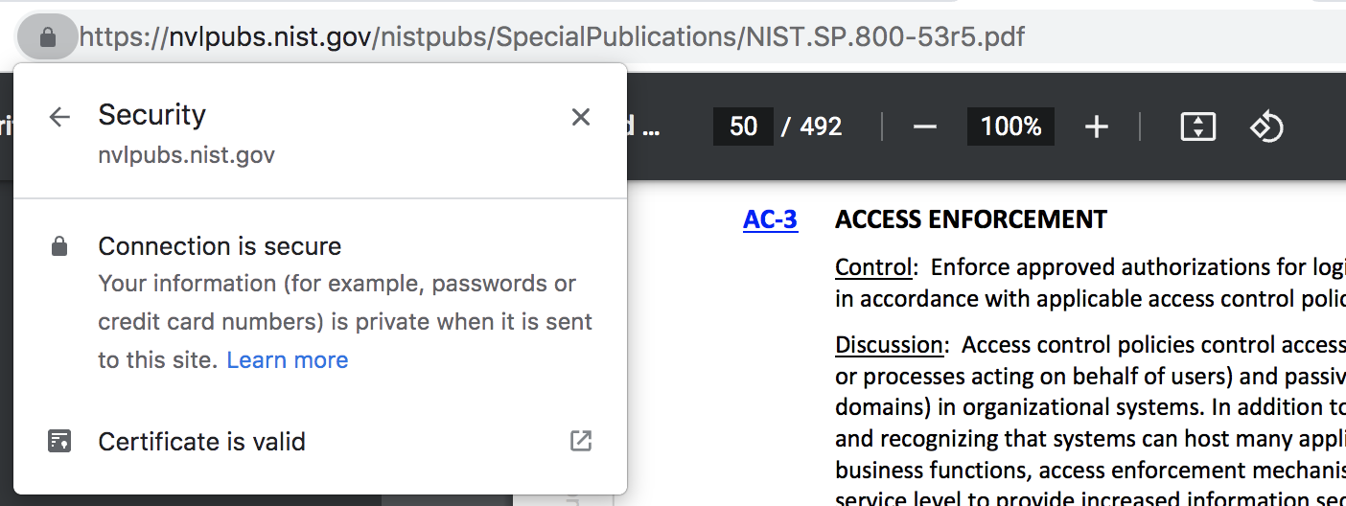
What manual cybersecurity practices?!
Firewall
Vulnerability
Scanning
Intrusion Detection
Of course, people define strategy
and requirements
Encryption
Of course, solutions are automated

Slide 4
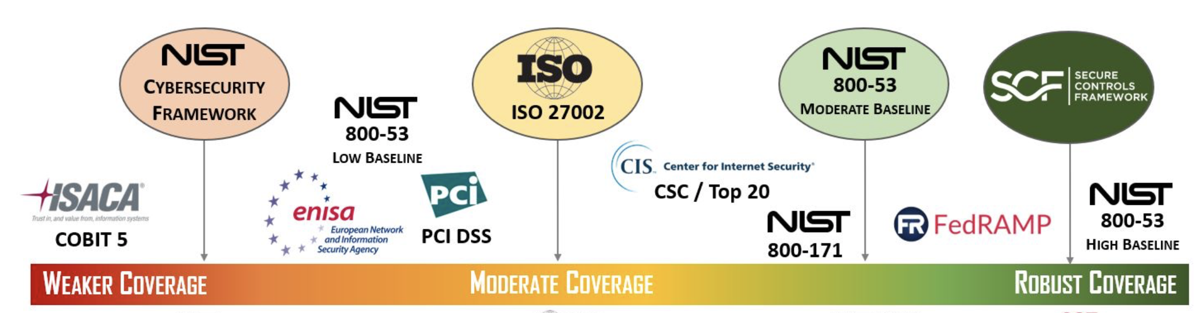

Cybersecurity = effective controls
Controls mitigate attacks
How do we select the right ones?
CNSSI
Controls = security requirements

Slide 5
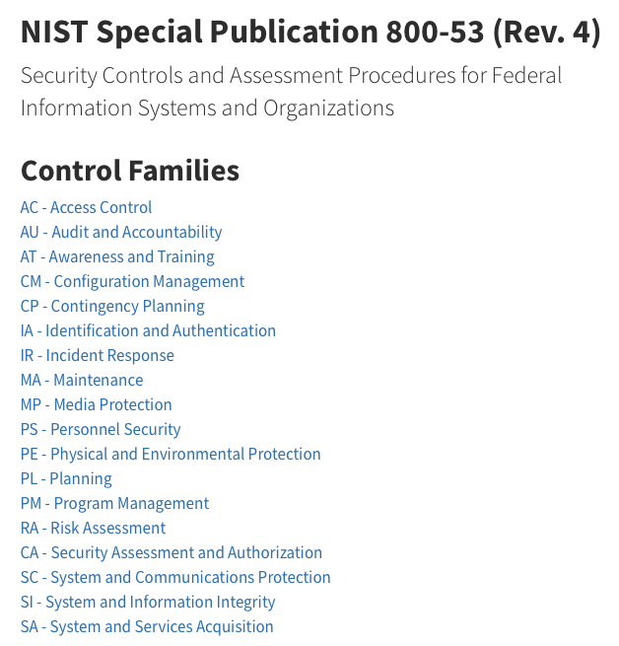
Reactive and Proactive Controls
Proactive
AT
CM
CP
PL
PM
RA
CA
SA
Reactive
AC
AU
IA
IR
MA
MP
PS
PE
SC
SI

Slide 6

Reactive and Proactive controls
at launch
Proactive
Reactive
how well we anticipate and predict attackers ?
what are the gaps that attackers can exploit ?
What gaps are they actually exploiting ?
Predict
Protect
how are we designing our cyberdefence ?
What are we prepared to do ?
How are we actually doing ?
Daily Performance of Cyberdefense
are there unanticipated gaps?
are attackers becoming more skillful ?
are attackers becoming more motivated?
do attackers gain knowledge?
do attackers get more resources?
do attackers improve tools ?
Assure ?
Cost of defense

Slide 7
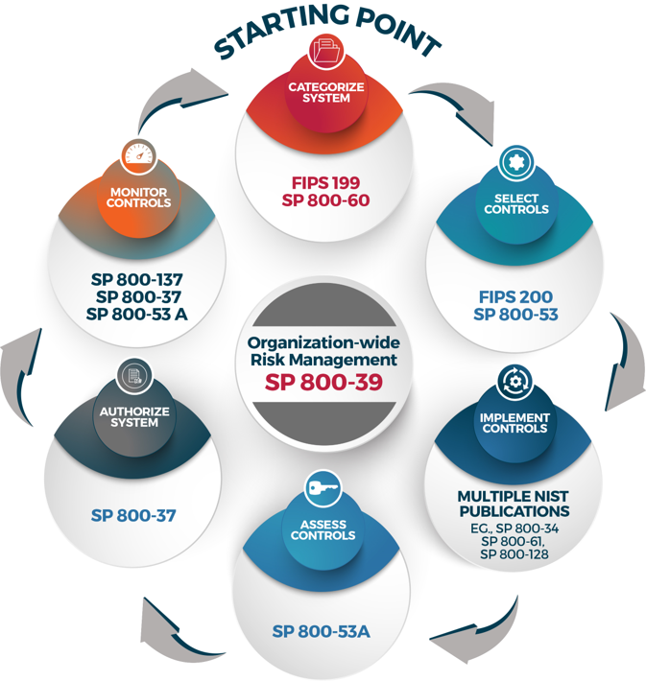
Risk Management Framework (RMF)
Daily Performance of Cyberdefense
Initial controls are set by regulator based on
the criticality of the system (and tailored to the system)
Cost of defense
Additional controls are suggested by risk assessment

Slide 8
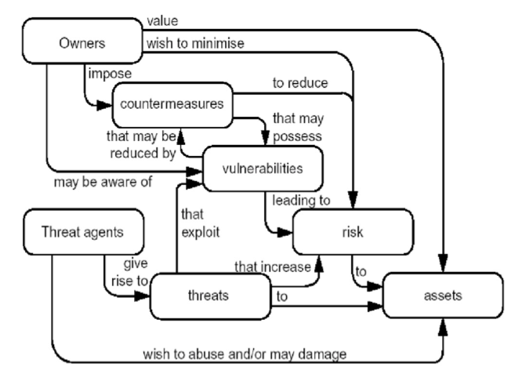
Risk: NIST 800-30 and ISO 15408
Risk is a specific situation which includes a set of predicted attacks on the system, achieving a certain common business impact
controls
Risk involves a certain attack surface and certain vulnerabilities, some or all of which may be mitigated by controls.
attacker
attack
Risk assessor makes claims about attacks, assets and risks

Slide 9

Manual practices …
Team is underqualified
Team is too small
There is too much information to process
That dude needs a bigger whiteboard

Slide 10
Correlating business impacts and attacks
There is one big problem is that the entire that is at the heart of cybersecurity that is and also very complex and that is currently solved using manual and subjective practices:
What situation we
want to avoid?
Where is the backdoor ?
How to systematically correlate
business impacts, and
the attack surface of the system that we are trying to protect, and
the capabilities of the attackers, and
the set of the required controls (defence policies, procedures, mechanisms and people)
What attacker can do ?
How and where do we mitigate?
Did we predict all attacks ?

Slide 11

Manual practices are inadequate and harmful
Failing to predict attacks and correlate to business impact is inadequate
Inadequate defense is harmful:
injury is caused by successful attacks;
budget is wasted on defense that does not work (cost of defense is $$$, there are still gaps, while business impact is $)

Slide 12
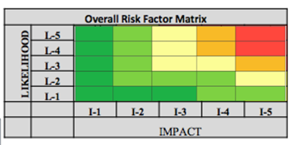

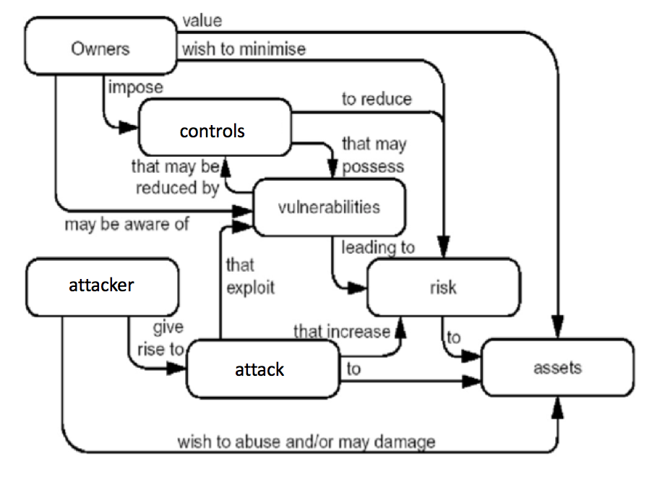
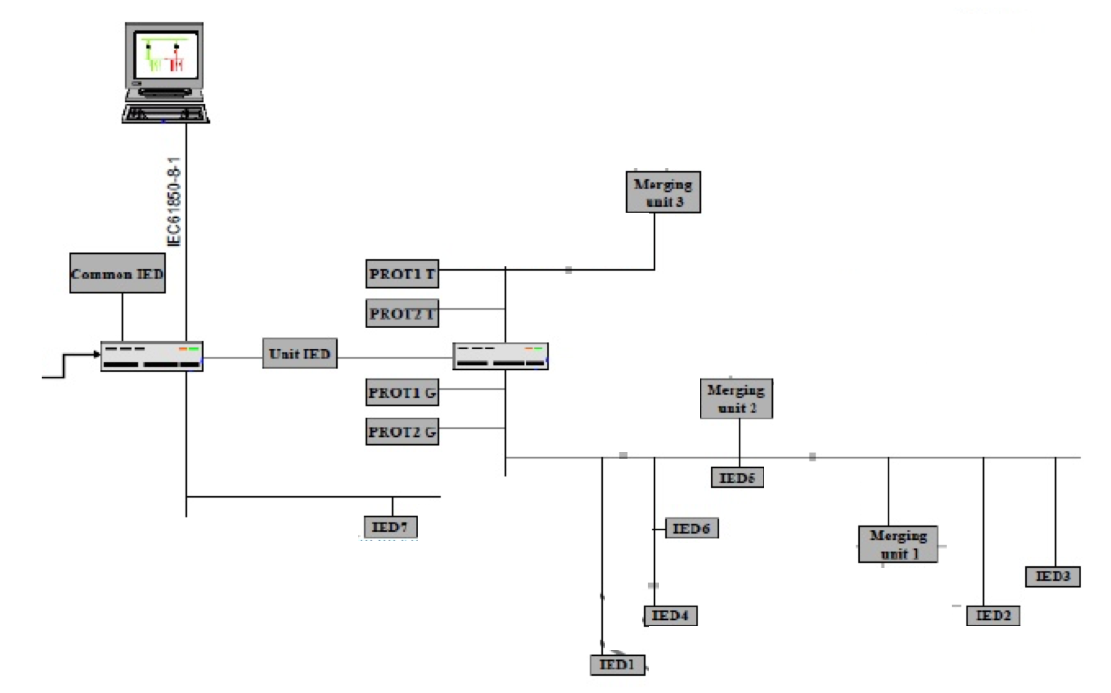
What is wrong with manual practices?
manual risk assessment is subjective and unsystematic
  risk claims are stated subjectively by individuals
  what is an “asset”, “attack”, “vulnerability”, “attacker” is interpreted subjectively by the individual
  claims are often made is isolation, not systematically derived from some known and commonly accepted facts about the system or about attacks
  subjective determination of what are possible attacks, impacts, etc.
claims are often made in isolation from each other (risks are not correlated to attacks or countermeasures; vulnerabilities are not correlated to attacks or risks; controls are not correlated to vulnerabilities)
there is no assurance argument (how do we know that we’ve identified all risks)
The process is long and costly
The process is not repeatable

Slide 13


How to automate manual practices ?
Digital Cybersecurity

Slide 14



Top-down vs bottom-up cybersecurity
Attack Tree = Correlation
Enterprise
Identified Risk
Business
process
NIST
800-53
Controls
System function
Architecture and design
Code control and data flow
Network flow
Vulnerability findings
Architectural model
Attack alerts
Attack tree can be constructed top-down
Notes:
This is important, because this allows mapping the findings of static code analysis tools (or even intrusion detection systems) to the risks identified at the business level. This is the key to the top-down bottom-up risk assessment approach.

Slide 15
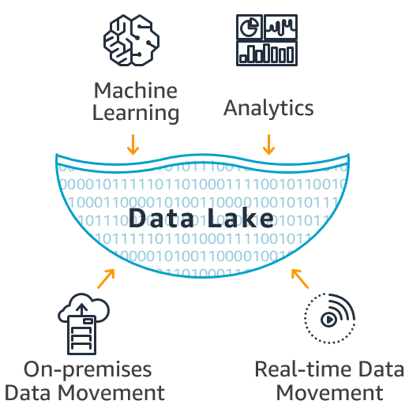
Risk claim is based on element claims
Risk R_{i} exists
because
Attacker At_{i.} has means and opportunity to
perpetrate an Attack TS_{i}
that causes Damage UE_{i}
to Asset A_{i}
by exploiting Vulnerability V_{i}
Digital assessment collects evidence to justify these claims
Notes:
More complex claims involve multiple vulnerabilities per attack, and multiple attacks per risk, causing the same damage

Slide 16
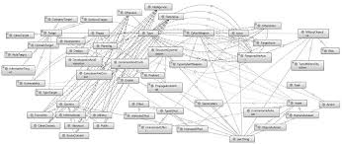
Digital Cybersecurity Platform
Cybersecurity ontologies
Digitized
system architecture
Vulnerability findings
Monitoring alerts

Slide 17
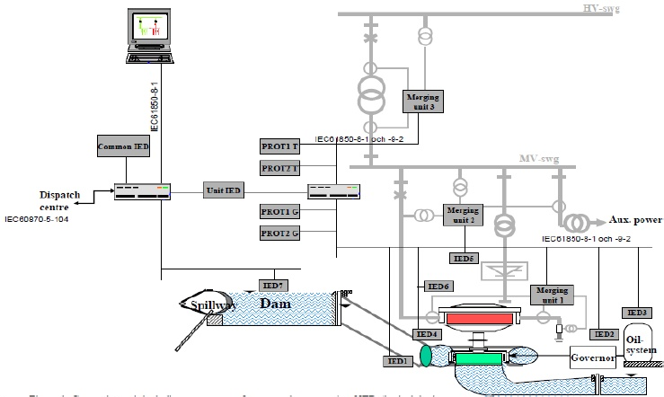
Full system architecture

Slide 18
Devices connected by data links

Slide 19
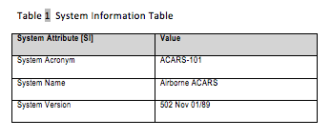
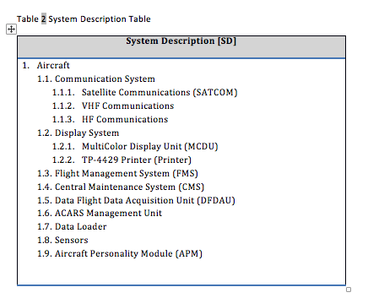
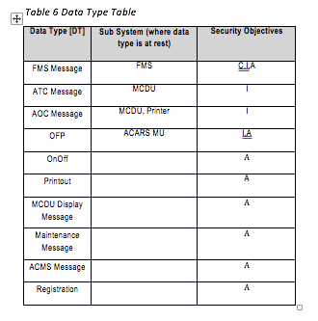
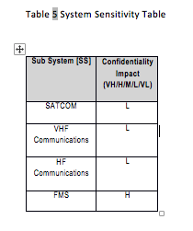
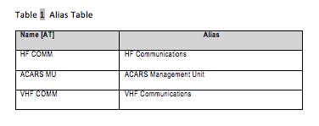

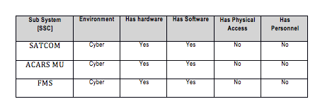
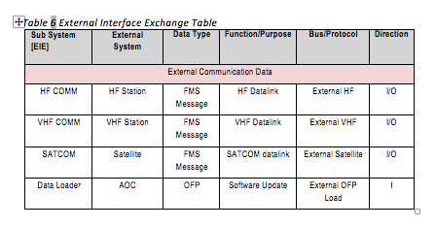
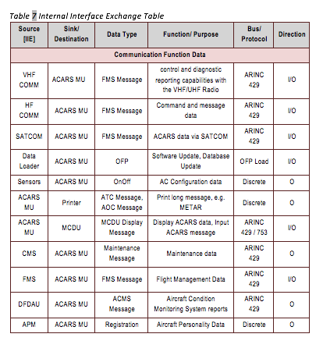
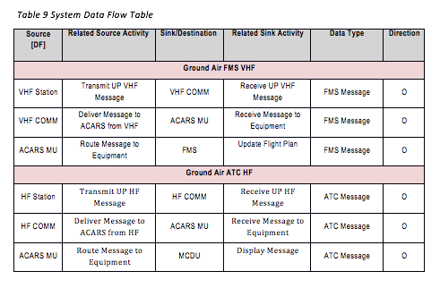

Digital content in tables

Slide 20
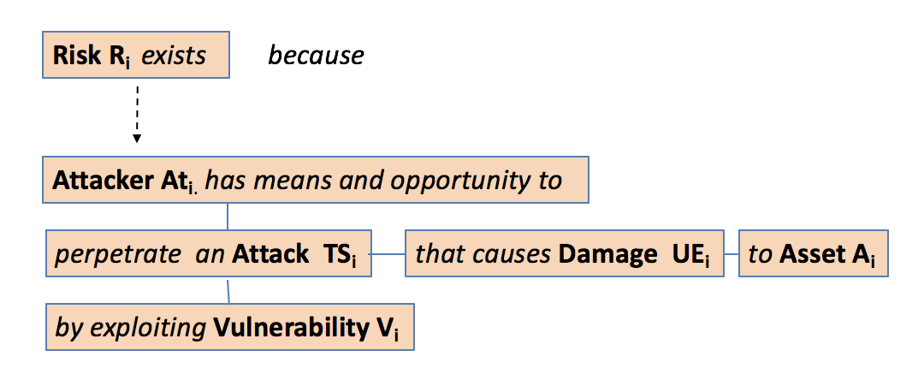

Digital Risk Assessment
System
Cybersecurity
Research
Digital Content
Upper Ontologies for Cybersecurity
Digital System Architecture
System Facts
System
Facts
Cybersecurity
Knowledge
Base
Unified Digital Risk Assessment
Methodology
Automated Risk Assessment
Methodology
Digital Risk Model
Automated assessment & reporting
Risk Analytics
Multiple Standards

Slide 21
What standards to adopt?
ISO/IEC 13335
ISO/IEC 15408
ISO/IEC 15443
ISO/IEC 27001
CRAMM (UK)
EBIOS (France)
Mehari (France)
Magerit (Spain)
HTRA (Canada)
NIST SP-800-30 (US)
NIST SP-800-39 (US)
Octave (SEI CMU)
RiskAn (Czech Rep)
Microsoft Threat Analysis
STRIDE
others
Challenges:
Decades old, pre-digital
Few approaches deal with discernable concepts to be digital
Few approaches are systematic enough to be automatable
None addresses assurance (How do we know that we’ve identified all risks?)
Digital System Architecture
Unified Digital Risk Assessment
Methodology
Digital Risk Model
Multiple Standards
For the modern
digital
ecosystem

Slide 22
Benefits of digital cybersecurity
select
authorize
prepare
categorize
implement
assess
Manual
2w
4w
12w
4w
2w
Digital
Digital-2
Digital-3

Slide 23
Questions ?

Slide 24
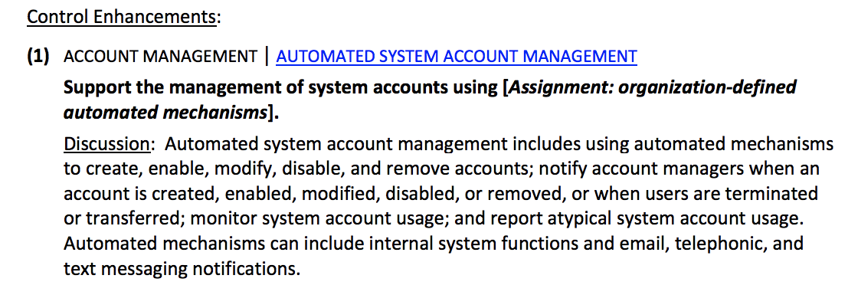
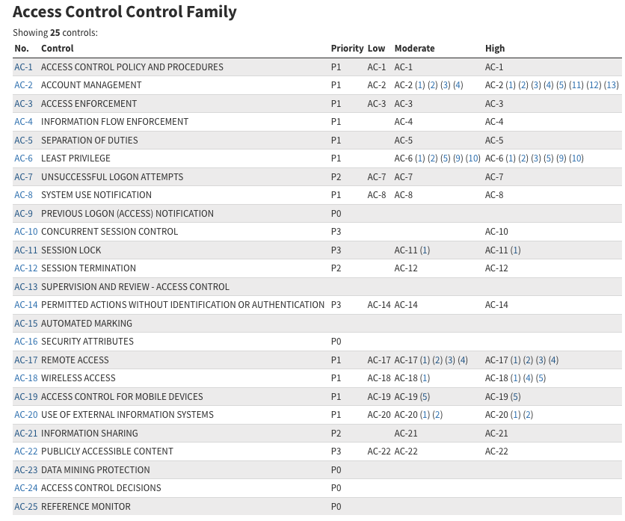
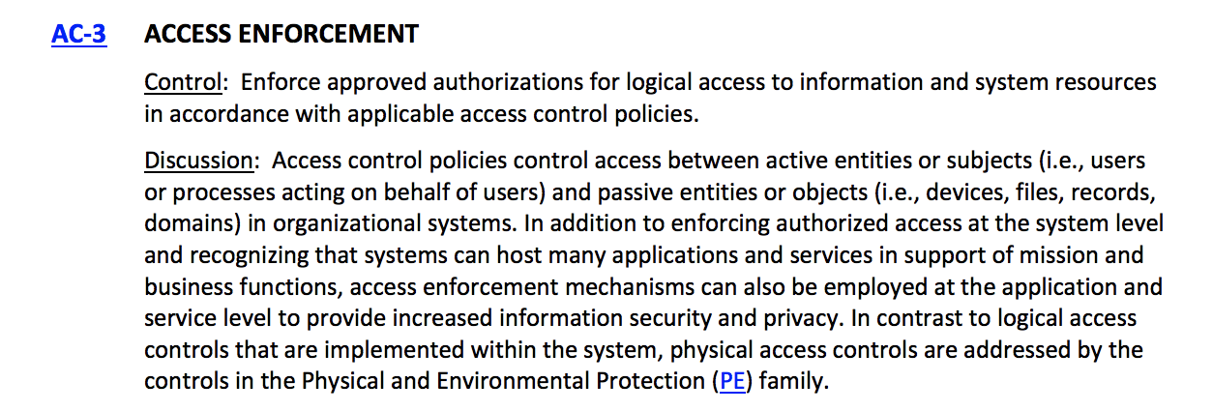
Example: NIST 800-53 controls
policies
procedures
people
mechanisms (software and hardware)

Slide 25
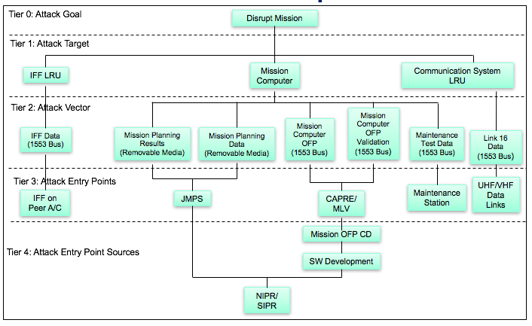
Example: Attack Tree

Slide 26
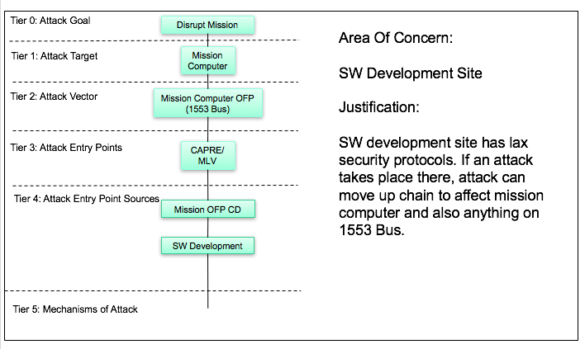
Investigate each attack path

Slide 27
Root causes
Insufficient digitization of architectures: we still need human to interpret system architecture diagrams and documents
Insufficient digitization of threat-risk-vulnerability space: we still need a human to interpret risk claims
Subjectivity of risk identification
Risk identification is not repeatable
Multiple silo technologies
Lack of cooperation
Lack of useful ontologies of attacks
Lack of standards

Slide 28
Top-down vs bottom-up cybersecurity
“Top” is two-fold:
1) system model linked to business processes; allows developing systematic risks in correlation with business impacts
2) top-down ontologies that allow developing systematic attack trees
Enterprise
Business
process
System function
Architecture and design
“Bottom” means foundation
facts that system defenders understand:
- configuration
- code
- monitoring alerts
- prior incident reports
- system security plan
Code control and data flow
Network flow
Architectural model
Notes:
This is important, because this allows mapping the findings of static code analysis tools (or even intrusion detection systems) to the risks identified at the business level. This is the key to the top-down bottom-up risk assessment approach.

Slide 29

What is a Data Lake?

Slide 30

Towards Digital Risk Assessment
System
Cybersecurity
Research
Digital Content
Automated import
Digital system description from system owner
System Facts
System
Facts
Cybersecurity
Knowledge
Base
Normalized internal representation for risk assessment
Notes:
MBRA is about using models for performing risk assessment

Slide 31
Digital Risk Assessment ?
ISO/IEC 13335
ISO/IEC 15408
ISO/IEC 15443
ISO/IEC 27001
CRAMM (UK)
EBIOS (France)
Mehari (France)
Magerit (Spain)
HTRA (Canada)
NIST SP-800-30 (US)
NIST SP-800-39 (US)
Octave (SEI CMU)
RiskAn (Czech Rep)
Microsoft Threat Analysis
STRIDE
others
System
Cybersecurity
Research
Cybersecurity
Research
Digital Content
Challenges:
Few approaches deal with discernable concepts to be automatable
Few approaches are systematic enough to be automatable
None addresses assurance (How do we know that we’ve identified all risks?)
Digital system description
System Facts
System
Facts
Cybersecurity
Knowledge
Base
Normalized internal representation for risk assessment
Risk Assessment
Methodology
Notes:
MBRA is about using models for performing risk assessment

