Slide 1
CyberSecurity
Fundamentals
Can we recognize our place in cybersecurity landscape and how to go forward?

Slide 2
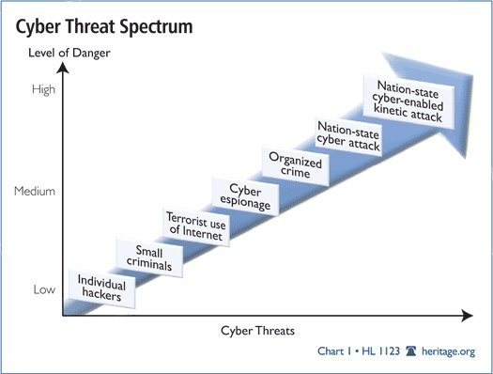
Why is Cybersecurity Important
Threat to extensive and detailed Information and System Assets
Threat to Nation’s Critical Infrastructure
Threat to National Security
Threat to National Prosperity
Crime

Slide 3

Cyber Threats on Global Scale
Some of significant August 2022 attacks:
Hackers used a DDoS attack to temporarily take down the website of Taiwan’s presidential office.
Hackers targeted the Finnish Parliament with a DDoS attack that rendered the Parliamentary website inaccessible.
Hackers targeted the website of Ukraine’s state energy agency responsible for the oversight of Ukraine’s nuclear power plants.
Hackers targeted the website of the Latvian Parliament with a DDoS attack that temporarily paralyzed the website’s server.
Hackers targeted Greece’s largest natural gas distributor DESFA causing a system outage and data exposure.
A Russian group claimed responsibility for breaching a privately owned UK water supply company South Staffordshire Water and leaking files in an extortion attempt.
Hackers targeted Montenegro’s government institutions, breaching the computer systems of several state bodies.
…….
Cheap and Easy
Uses technology readily available on the internet
Maximizing options for opportunistic gain
Ubiquitous and agile
Comes from Anywhere and it can strike Anytime
Shifting to direct targeting of internal networks
Increased Sophistication
Organized and knowledge sharing, more difficult to track attacks (use of complex routing, proxies and dummy hosts)
Proliferation
As use of computers and network broadens, everyone is a node in a network and open to cyber attacks
Advancing social engineering and malware capability
Scale, Sophistication and Impact of today’s cyber threats are constantly increasing
May 2020. German officials found that a Russian hacking group associated with the FSB had compromised the networks of energy, water, and power companies in Germany by compromising the firms’ suppliers.

Slide 4
Ransomware – Fast Emerging Business Risk
Ransomware attacks not just a cybersecurity risk, but also an enterprise-wide risk, threatening business continuity and operations.
Ransomware statistics - according to Government and other various sources
  Daily attack occurrences: 4000
  80 % of companies that paid ransom experience immediately another attack
  Victims paid $350M in 2020
  Attacks will cost its targets $265B by 2031
  Increase in the average ransom payment: 104% since 4Q2019
  Average time for system outages: 19 days
  92% of companies that paid ransom do not get all their data restored

Slide 5
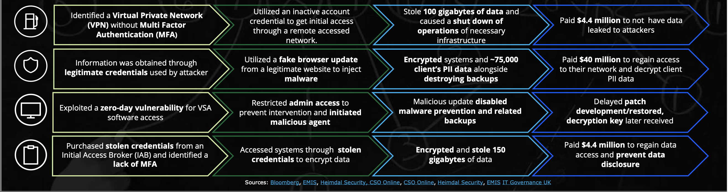
Ransomware Industry Examples

Slide 6
Cybersecurity Landscape

Slide 7
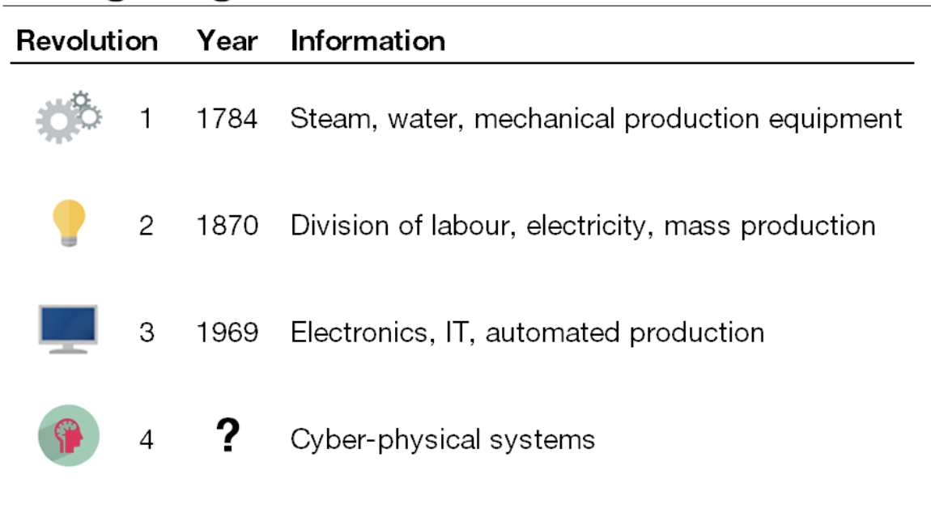

Enterprises Flourish in Complex Digital Age
Digital interaction with clients and customers
Leveraging the latest technological innovation
Converging IT/OT and interconnecting supply chain
AI/ML era from self-driving cars/drones to SW to invest

Slide 8
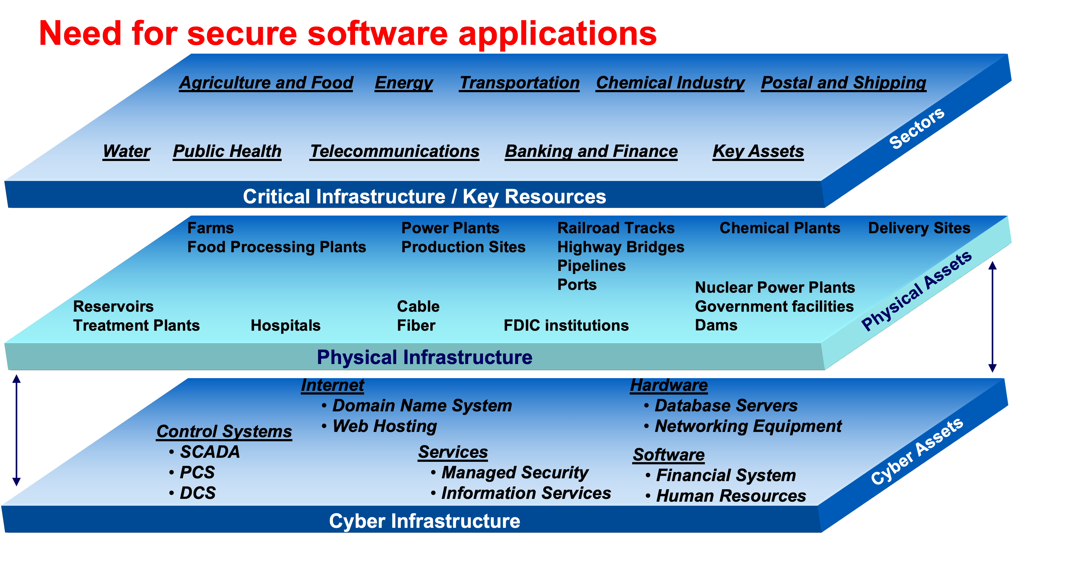
Cyber & Physical Space are Progressively Intertwined Instigating Increase in Ever Increasing Cyber Risk
“In an era riddled with asymmetric cyber attacks, claims about system reliability, integrity and safety must also include provisions for built-in security of the enabling software.”

Slide 9
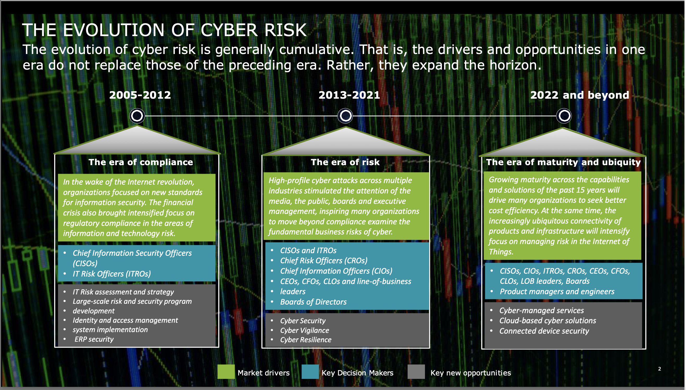

Source: Andrew Morrison, Principal, US Leader Cyber Strategy, Feb. 2022

Slide 10
Starting Point to Manage Cyber Risk
Polices
  National Cybersecurity Policy
Regulations
  Defense Federal Acquisition Regulation (DFAR)
Standards
  FIPS 199: Standard for Security Characterization
  Network Code on Cybersecurity (ENTSO-E)
  The Network Code on Cybersecurity aims to set a European standard for the cybersecurity of cross-border electricity flows. It includes rules on cyber risk assessment, common minimum requirements, cybersecurity certification of products and services, monitoring, reporting and crisis management. This Network Code provides a clear definition of the roles and responsibilities of the different stakeholders for each activity.
Frameworks
  NIST 800-37: Risk Management Framework (RMF)
Catalogs
  NIST 800-53: Security Controls
Guidelines
  NIST 800-30: Guide for Conducting Risk Assessments
Methods/Procedures
  NIST 800-53a: conducting assessments of security and privacy controls
Protocols
  SCAP – for identifying known vulnerabilities

Slide 11
Basic Resources That Every Organization Needs to Know
What IT systems do I have in my enterprise?
CPE (Platforms)
What known vulnerabilities do I need to worry about?
CVE (Vulnerabilities)
What vulnerabilities do I need to worry about right now?
CVSS (Scoring System)
How can I configure my systems more securely?
CCE (Configurations)
How do I define a policy of secure configurations?
XCCDF (Configuration Checklists)
How can I be sure my systems conform to policy?
OVAL (Assessment Language)
How can I be sure the operation of my systems conforms to policy?
CWE (Weaknesses)
What attacks can exploit which weaknesses?
CAPEC (Attack Patterns)
How can we recognize malware & share that info?
MAEC (Malware Attributes)
What events should be logged, and how?
CEE (Events)
How can I aggregate assessment results?
ARF (Assessment Results)
What weaknesses in my software could be exploited?
OCIL (Interactive Language)
What observable behavior might put my enterprise at risk?
CybOX (Cyber Observables)
ATT&CK
A Security Technical Implementation Guide (STIG)
SCAP
Information sharing
  STIX/TAXII
  National Information Exchange Model (NIEM)
  Emergency Data Exchange Language (EDXL)

Slide 12
Achieving Resilience in Digital Age (1)
Implement simple basic best practices
  Policies
    Create and regularly review cybersecurity policies for the organization
  Cyber Hygiene
    Insist on periodic password changes and work backups, and install preventive software
  Solid Backups
    Regular scheduling of offsite data backups of organization hard drives may make reinstalls easier after an attack
  Preventative Software
    Install cybersecurity software on all computers and regularly review them
  Least Privilege Access
    Set up “The Principle of Least Privilege” (PoLP). Give users minimum levels of access—or permissions—needed to perform their job functions
  Segmentation Network
    Set up network segmentation within your organization
  Continuous Monitoring
    Continuous security monitoring (CSM) will automate monitoring of information security controls, vulnerabilities, and other cyber threats and support organizational risk management decisions.

Slide 13
Achieving Resilience in Digital Age (2)
Getting the fundamentals right
  Understand criticality of your most important assets
  Adopt security posture relevant to your risk profile
  Build robust monitoring and response plan
Use automation to understand and protect
  Adopt new solutions for better prevention (proactive) and faster detection (reactive)
  Understand how your system can be attacked through risk assessment
    Systematic identification of attack path
    Comprehensive identification of high risks
  Manage your assessment data as evidence
Having the right talent
  Deploy critical skillsets
  Grow and enable a new cybersecurity leaders through continuous training and education

Slide 14
Accomplishment Since Last Meeting

Slide 15
BiH Represented Internationally
Presented 2 papers at International CIGRE Paris on cybersecurity for Power Systems
  Case Study with Elekrtoprivreda leveraging automated risk assessment platform
  Role of digital engineering in cybersecurity of Electrical Grid
Presented a paper at regional CIGRE - SEERC Vienna on cybersecurity for Power Systems
  Topic: Cross Border Cooperation – Cyber Security
    Case study with Elektroprivreda: Cooperation through Automation

Slide 16
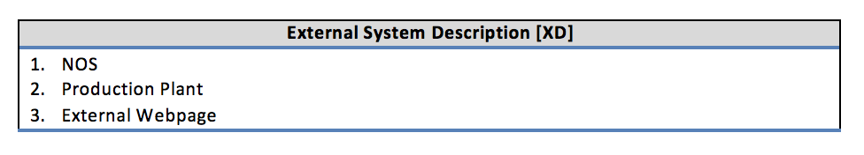
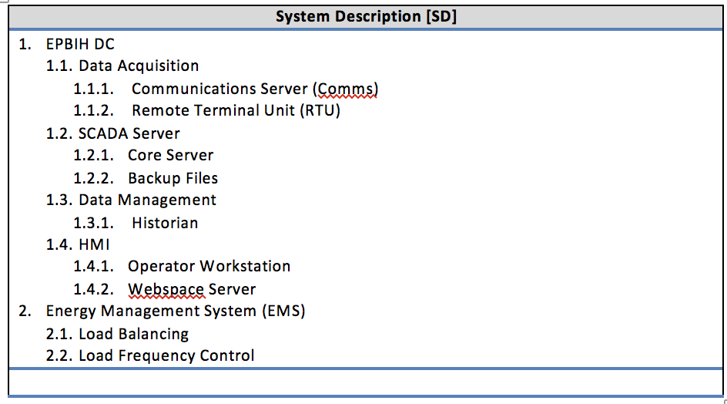
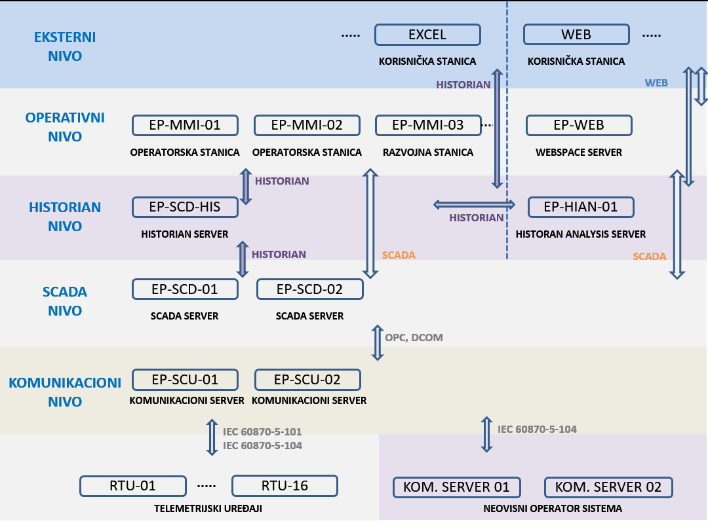
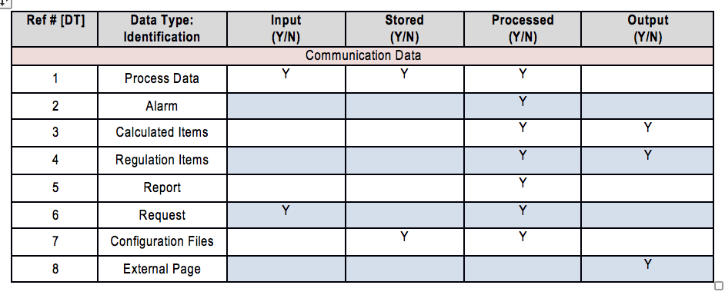
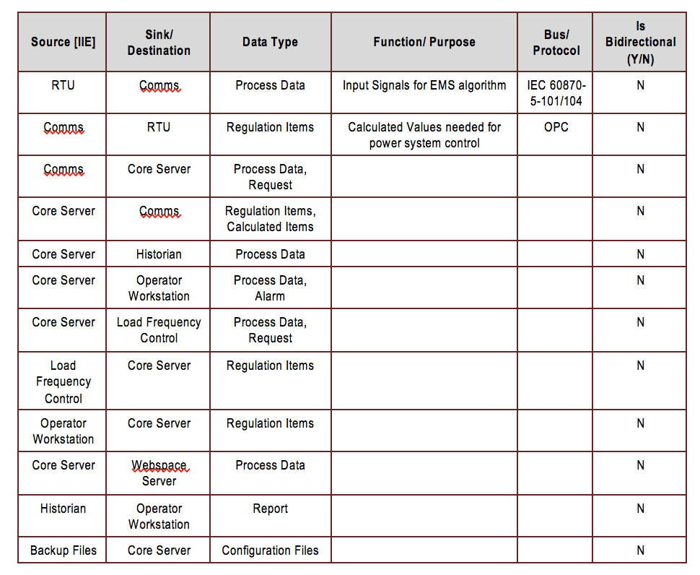

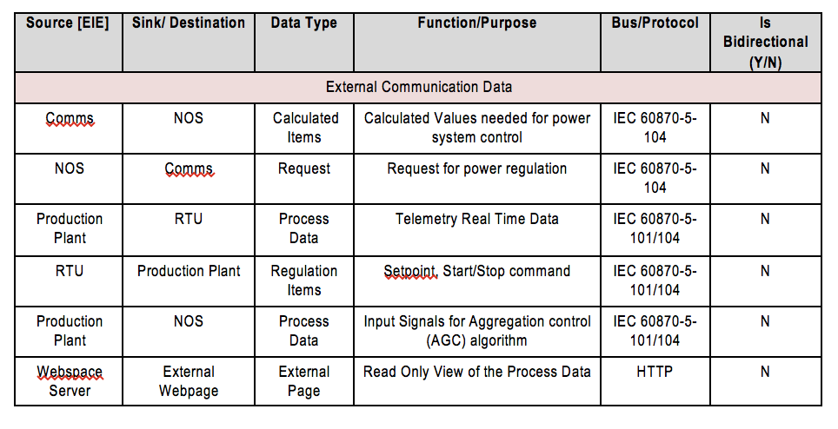
Case Study – Elektroprivreda BiH Production SCADA
Digital/machine readable representation of Production SCADA
Informal representation of Production SCADA

Slide 17
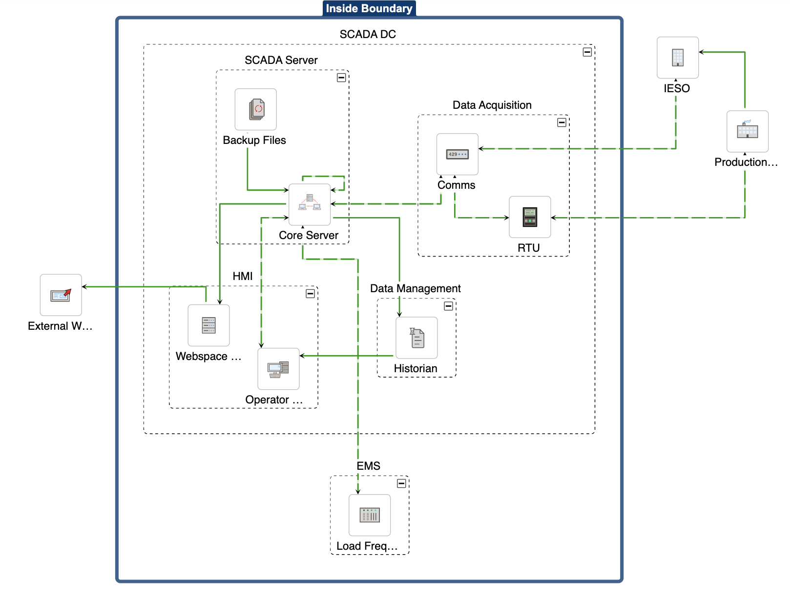
From system description to auto-generated graphical model

Slide 18
Results of Case Study
Step 1: Initial (Row) Risk Assessment
The Results:
30 sensitive assets identified
161 threat events
28 attacker types
1327 attacks
40 risks:
  1 Very High; 5 High;
  25 Moderate;
  5 Low; 4 Very Low
Initial (Row) Risk Assessment does not consider any already implemented mitigations
Top 6 Risks
More detailed information such as risk distribution among assets, threats, nodes links is automatically generated

Slide 19
Results of Case Study
Step 2: Mitigated Risk Assessment
Results after auto-mitigation of top 6 risks:
Overall Risk Level is Low
Levels of 40 risks changed:
  0 Very High; 0 High;
  1 Moderate;
  30 Low; 9 Very Low
Control Id | Control Name | Target Name | Target Element | Effective? | In 'Very Low Impact Controls' baseline? | Guidance
AC-19 | Access Control for Mobile Devices | Core Server | Performer | Yes | Yes | The organization: a. Establishes usage restrictions, configuration requirements, connection requirements, and implementation guidance for organization-controlled mobile devices
AC-18 | Wireless Access | Core Server | Performer | Yes | Yes | The organization: a. Establishes usage restrictions, configuration/connection requirements, and implementation guidance for wireless access b. Authorizes wireless access to the information system prior to allowing such connections.
AC-17 | Remote Access | Core Server | Performer | Yes | Yes | The organization: a. Establishes and documents usage restrictions, configuration/connection requirements, and implementation guidance for each type of remote access allowed and b. Authorizes remote access to the information system prior to allowing such connections.
Set of reports automatically generated:
Risk Assessment Report (RAR)
Security requirements

Slide 20

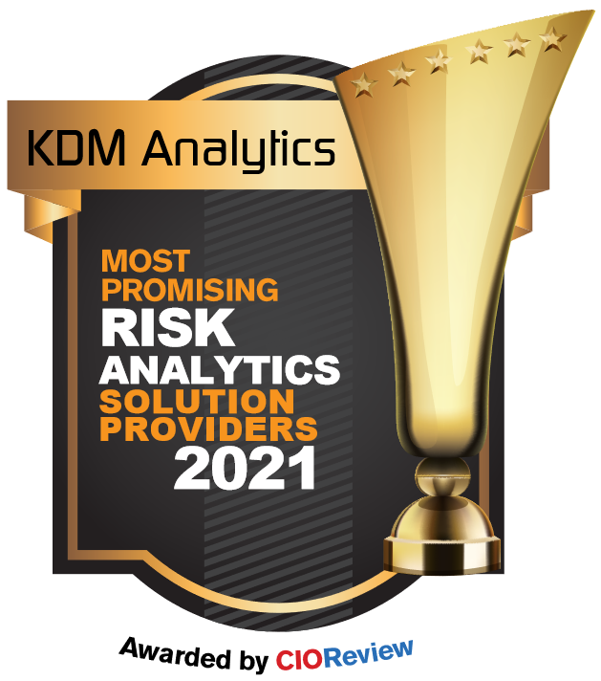
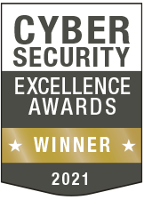
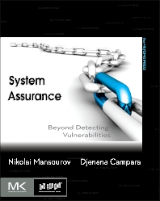
Accolades & Publications
We are proud to present our most recent awards and accolades:
Most Promising Risk Analytics Providers 2021
GOLD:2021 Cybersecurity Excellence Awards
System Assurance: Beyond Detecting Vulnerabilities

Slide 21










Security leaders rely on us

Slide 22
Q&A

Slide 23
Thank you
For more information on our products and services, please contact us though the following:
Contact:
General Inquiries:
Djenana Campara
President & CEO
email: djenana@kdmanalytics.com
phone: +1 613-867-7918
email: info@kdmanalytics.com
phone: +1 613-627-1010
offices:
Ontario, Canada
New York, USA

